Slide 1


DEPARTMENT OF COMPUTER SCIENCE AND ENGINEERING
Project name : Traffic Management
Team name : proj_224783_Team_5
Team members : DHANUSH J (113321104016) DEVANAND C(113321104012)
DHANUSH D(113321104015)
DASETTI MAHESH(113321104011)

Slide 2
OBJECTIVES
Enhance Safety: Improve road safety by monitoring and responding to accidents and hazards in real-time, as well as facilitating safer road designs.
Optimize Traffic Flow: Minimize congestion, reduce travel times, and enhance overall traffic flow by using data to control traffic signals and provide real-time routing information.
Reduce Environmental Impact: Mitigate environmental effects by optimizing traffic patterns, reducing emissions, and promoting eco-friendly transportation alternatives.

Slide 3
Efficient Resource Allocation: Optimize the use of resources such as road infrastructure, public transportation, and emergency services based on real-time demand and conditions.
Enhance Public Transportation: Make public transportation more attractive and efficient by providing real-time information on schedules, routes, and vehicle availability.
Improve Emergency Response: Enable faster and more efficient emergency response by using IoT data to direct first responders to incidents and accidents

Slide 4
Project
4G Solar-powered Traffic Sensing Camera
4G · Solar-powered · Radar Triggered Object Capture · AI Algorithm · Low Consumption Technology · MQTT Protocol · Wi-Fi For Web GUI Configuration · Large Capacity Battery · IP66 · 3-Axis Ball Mounting Bracket
AI Road Traffic Pro Bullet Plus Camera
Milesight AI Road Traffic Pro Bullet Plus Camera, with top-notch STARVIS Starlight Sensor, can provide detailed clear images in low and near-infrared light conditions down to 0.002Lux (Color) and 0Lux (B/W), ensuring good performance for 24/7 traffic monitoring.
AI Road Traffic Radar Pro Bullet Plus Camera
Milesight AI Road Traffic 5G Pro Bullet Plus Camera can transmit data wirelessly by simply inserting a SIM card, eliminating the need of complicated network cable and fiber connections. Thus, it greatly assists in the traffic management in situations where temporary traffic control, costly network deployment, or bothersome wiring are inevitable.

Slide 5
AI Road Traffic Supplement Light Pro Bullet Plus Camera
A rich set of interfaces such as DC, Audio I/O and Alarm I/O are available to offer more choices for easy management and various needs. For example, the alarm interface allows easy integration with traffic light control systems, ensuring smooth operation and compatibility.
AI Road Traffic PTZ Bullet Plus Camera
he vehicle counting result based on vehicle type and various vehicle features can be shown intuitively in camera's live view and the camera can also generate useful report insights to further enhance traffic management capabilities.
AI Road Traffic Speed Dome Camera
Milesight AI Road Traffic Speed Dome Camera is designed to extend user's reach to the max with the fast 5.7~205.2mm @F1.55~F4.8 lens. The 36X optical zoom allows the user to zoom up to distant subjects while still maintaining the clarity, delivering high quality video over the entire zoom range.
Entrance & Exit AI LPR Bullet Camera
With the built-in AI LPR algorithm and embedded black and white lists, Milesight Entrance & Exit AI LPR Cameras enable to achieve stand-alone solutions for license plate recognition as well as no-plate vehicle detection. Alarm is triggered as soon as the corresponding rule-compliant license plate is detected, enabling efficient and accurate access control at any gate, such as a campus or an apartment.

Slide 6
Indoor Parking Guidance Camera
Milesight Indoor Parking Guidance Camera is equipped with dual lens, allowing it to efficiently monitor up to 6 parking spaces (3 on each side) using just one camera. Moreover, the lens can be flexibly adjusted as needed to provide optimal coverage for the parking spaces.
AI Outdoor Parking Management Pro Bullet Plus Camera
High accuracy and real-time people counting based on AI algorithm, with statistic reports for further analysis, helps to make fast decisions on security management and increase the operational efficiency of the business.
Entrance & Exit AI LPR Pro Dome Camera
With built-in AI LPR algorithms and embedded black and white lists, Milesight Entrance & Exit AI LPR Cameras enable a standalone license plate recognition solution for fast implementation scenarios such as gates or barrier control with high efficiency and accuracy. It can also be used with Milesight's own back-ends, including Milesight NVR, CMS and Milesight VMS Enterprise, to form a fully closed-loop traffic solution.
LoRaWAN® Ultrasonic Distance/Level Sensor EM310UDL
EM310-UDL is a LoRaWAN® ultrasonic distance/level sensor mainly used for detection of waste bin and other container’s level. With a compact size and wide measure range, EM310-UDL can be installed to any types of waste bins or containers to monitor solid or liquid level.

Slide 7
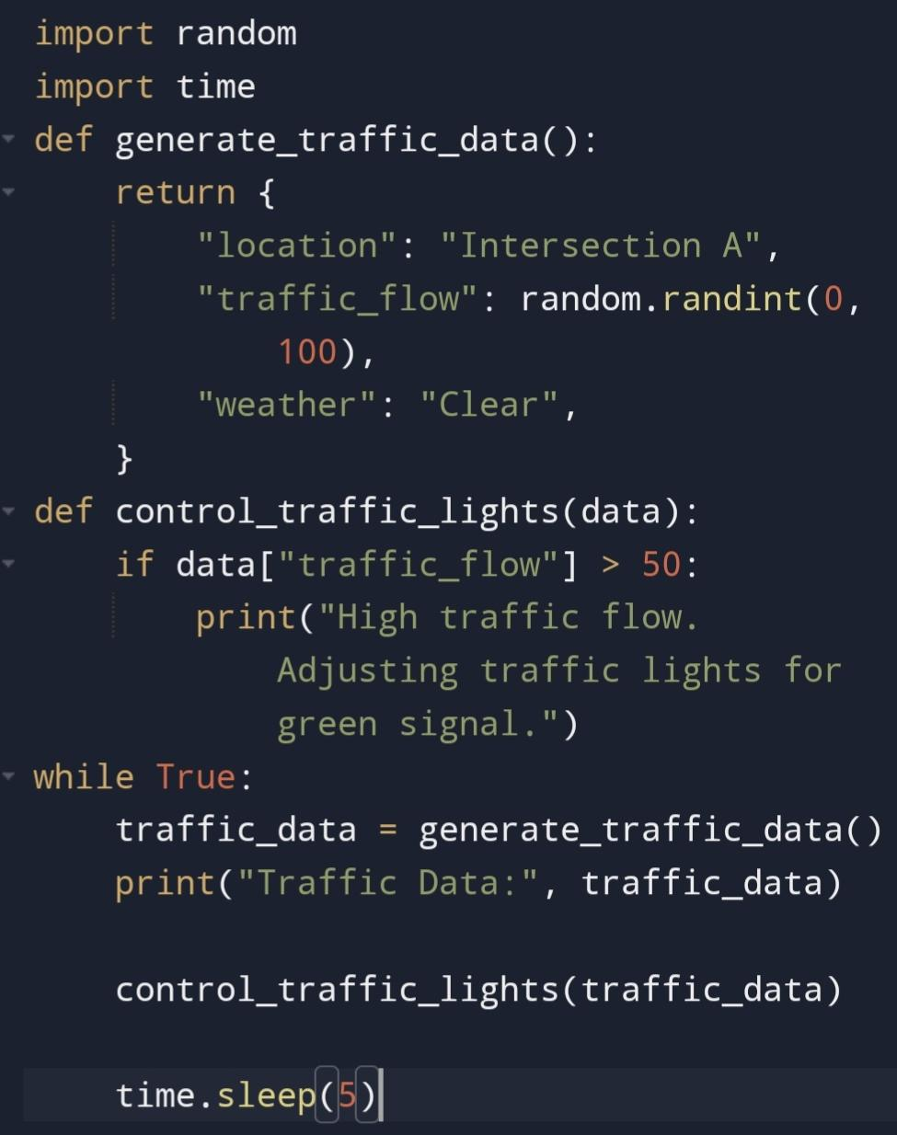
CODE IMPLEMENTATION

Slide 8
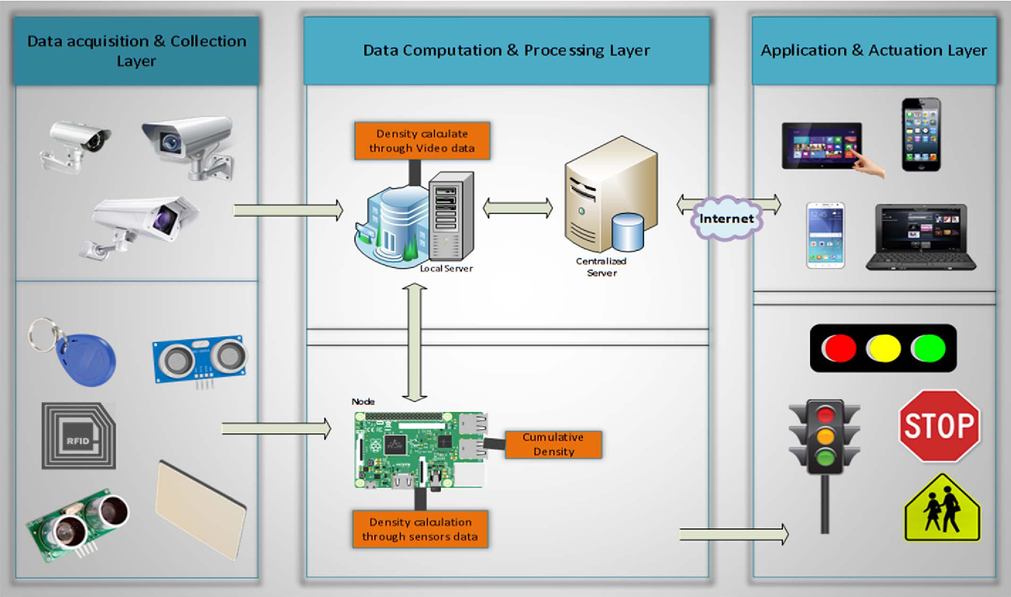
IOT DESIGN

Slide 9
CONCLUSION In conclusion, a well-designed traffic management system plays a crucial role in enhancing road safety, reducing congestion, and improving overall transportation efficiency. By utilizing technologies like traffic lights synchronization, real-time traffic monitoring, and data analytics, cities can make significant strides in managing traffic effectively. Additionally, promoting sustainable transportation options and public awareness can further contribute to a smoother and more sustainable urban mobility landscape. Overall, the implementation of a comprehensive traffic management system is essential for modern cities to address the challenges of urbanization and create a more livable and efficient environment for their residents.

Slide 10
THANK YOU

